Slide 1
ENGG404 – Lecture Case 8 Lac-Mégantic / MMA Train Disaster
Renato Macciotta, Ph.D., P.Eng.
Industrial Professor
School of Engineering Safety and Risk Management
* Images and information according to TSB 2014a and b (with permission)

Slide 2
Outline and Learning Outcomes
Context – Rail transport
LO: Learn the application of some metrics and methods for evaluating risk at an industry level (lagging indicators) – Risk management process, risk criteria and evaluation
Lac-Mégantic Case Study
LO: Identify weaknesses in the Risk Management System based on factual information of an incident investigation – Management Leadership, Audits
Activity: Risk Management Systems – where did they fail?

Slide 3
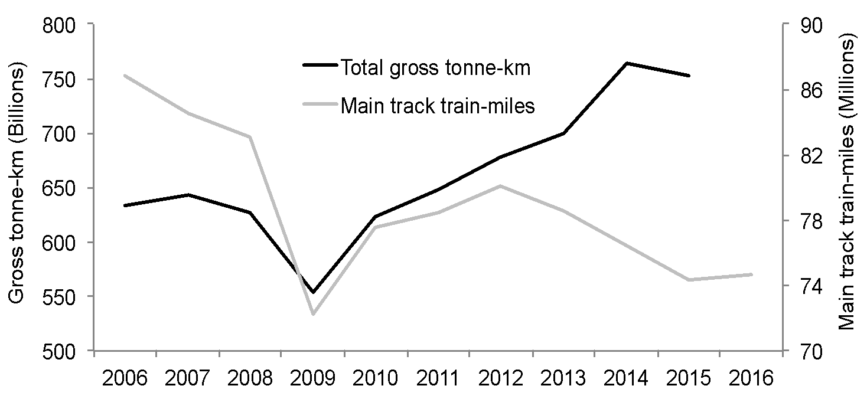
Rail transport in Canada
Railways play a major role in the Canadian economy. The Canadian railway network provides access to the United States (US) market and ports throughout North America. Railways move about half of Canada’s exports (by volume) and more than 70% of all intercity surface goods each year.
*Based on publicly available data from Transport Canada and Statistics Canada (downloaded 2017)

Slide 4
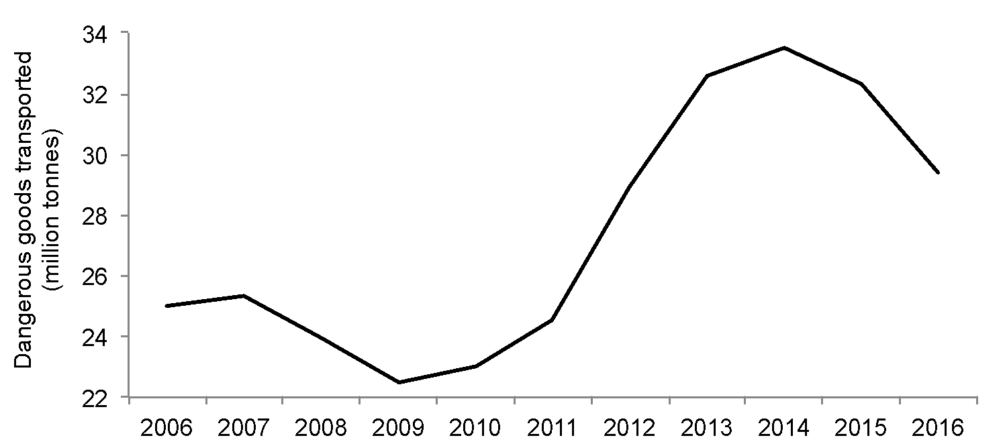
Rail transport in Canada
There has been an increase of almost 50% in the transportation of dangerous goods between 2009 (22.5 million tonnes) and 2014 (33.5 million tonnes) followed by a decline in the last two years (down to 29.4 million tonnes in 2016).
*Based on publicly available data from Transport Canada and Statistics Canada (downloaded 2017)

Slide 5
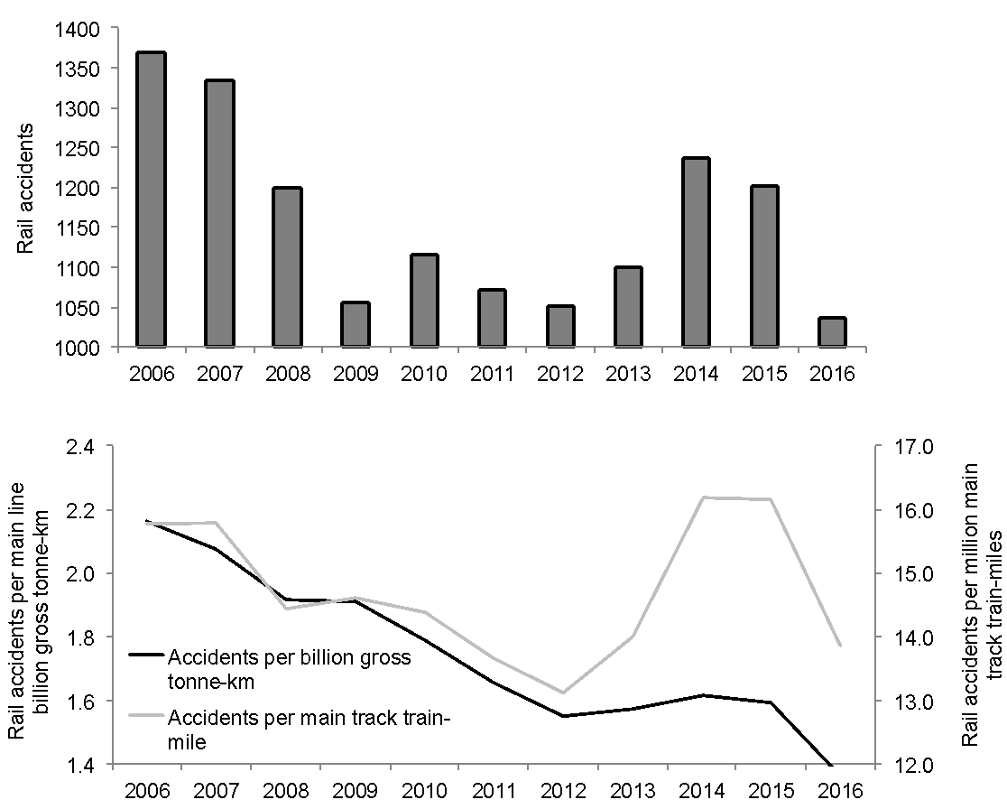
Rail transport in Canada
Efforts for enhancing rail transport safety are reflected in incident statistics.
*Based on publicly available data from Transport Canada, Transportation Safety Board and Statistics Canada (downloaded 2017)

Slide 6
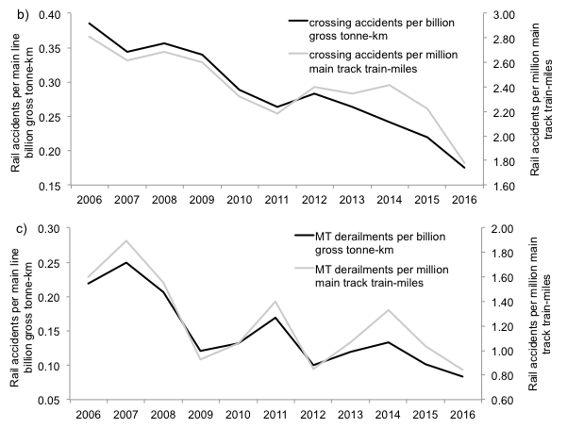
Rail transport in Canada
Crossing accidents and Main-track derailments.
*Based on publicly available data from Transport Canada, Transportation Safety Board and Statistics Canada (downloaded 2017)

Slide 7
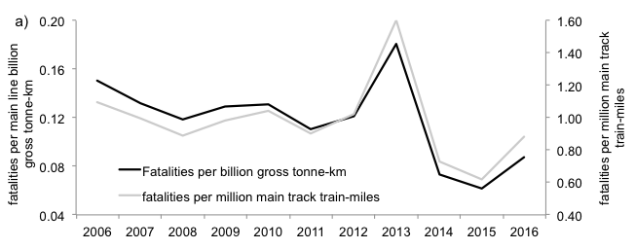
Rail transport in Canada
In terms of fatalities per year
*Based on publicly available data from Transport Canada, Transportation Safety Board and Statistics Canada (downloaded 2017)

Slide 8
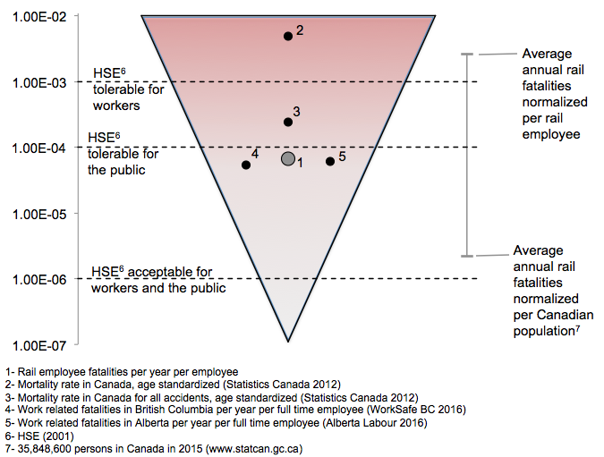
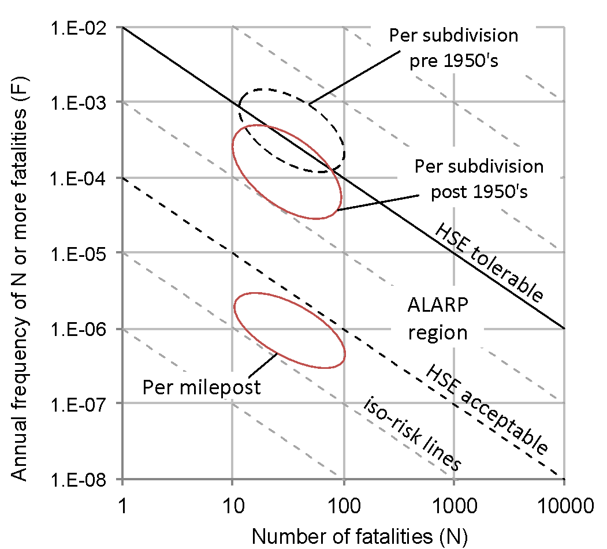
Rail transport in Canada
Level of associated risks?
1) Scale of the problem, 2) Potential for large number of fatalities, 3) Tolerable risk = tolerable consequence?

Slide 9
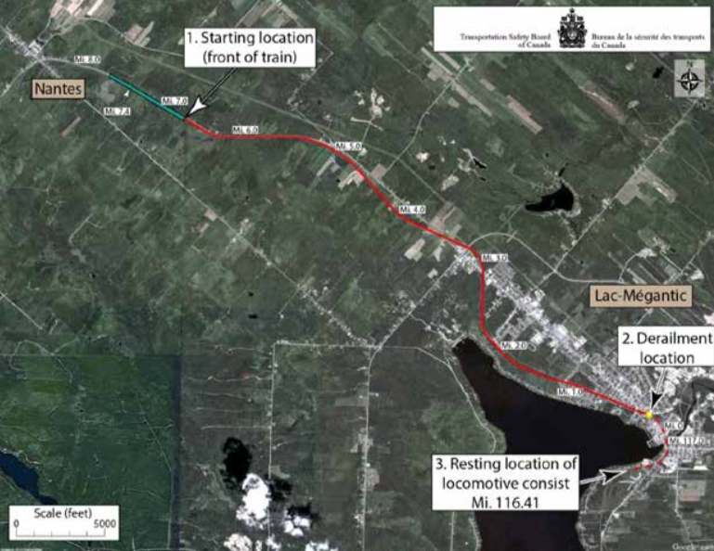
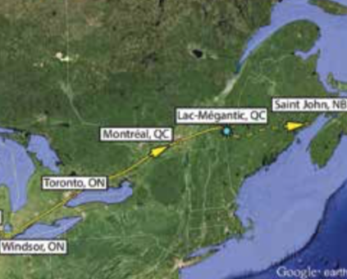
Lac-Mégantic
On the evening of July 5, 2013, at about 10:50 p.m., a Montreal, Maine & Atlantic Railway (MMA) train arrived at Nantes, Quebec, carrying 7.7 million litres of petroleum crude oil in 72 Class 111 tank cars
The locomotive engineer parked the train on a descending grade on the main track. A replacement engineer was scheduled to continue the trip east in the morning.
The engineer applied hand brakes on all five locomotives and two other cars, and shut down all but the lead locomotive.
*Based on Transportation Safety Board (2014 a and b) – with permission

Slide 10
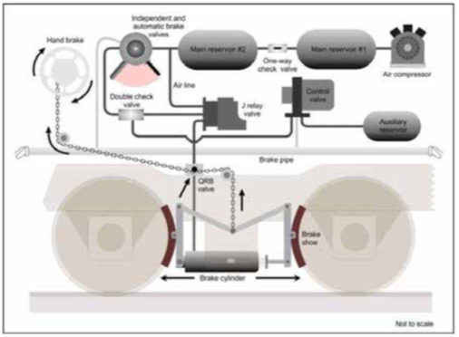
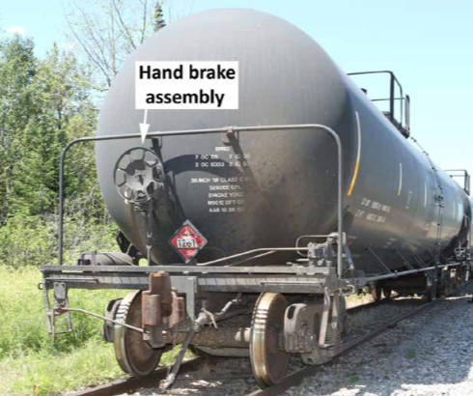
Lac-Mégantic
Railway rules require hand brakes alone be capable of holding a train, and this must be verified by a test. That night, however, the locomotive air brakes were left on during the test, meaning the train was being held by a combination of hand and air brakes. The status of train was notified to traffic controllers.
the engineer indicated that the lead locomotive had experienced mechanical difficulties throughout the trip, and that excessive black and white smoke was coming from its smoke stack. Because they expected the smoke to settle, it was agreed to leave the train as it was and deal with the situation the next morning.
*Based on Transportation Safety Board (2014 a and b) – with permission

Slide 11

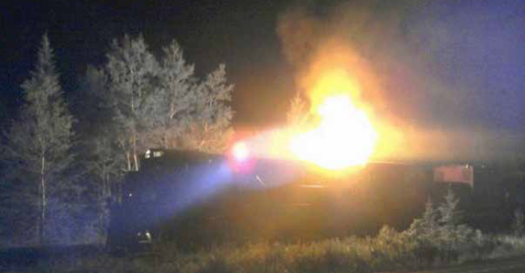
Lac-Mégantic
In October 2012, eight months before this accident, the lead locomotive was sent to MMA’s repair shop following an engine failure.
Given the significant time and cost of a standard repair, and the pressure to return the locomotive to service, the engine was repaired with epoxy-metal-like material that lacked the required strength and durability. This material failed in service, leading to engine surges and excessive black and white smoke.
Eventually, oil began to accumulate in the body of the turbocharger, where it overheated and caught fire on the night of the accident.
*Based on Transportation Safety Board (2014 a and b) – with permission

Slide 12
Lac-Mégantic
Shortly after the engineer left, the Nantes Fire Department responded to a 911 call reporting a fire on the train. After shutting off the locomotive’s fuel supply, the firefighters moved the electrical breakers inside the cab to the off position, in keeping with railway instructions.
They then met with an MMA employee, a track foreman who had been dispatched to the scene but who did not have a locomotive operations background.
With all the locomotives shut down, the air compressor no longer supplied air to the air brake system. As air leaked from the brake system, the main air reservoirs were slowly depleted, gradually reducing the effectiveness of the locomotive air brakes.
*Based on Transportation Safety Board (2014 a and b) – with permission

Slide 13
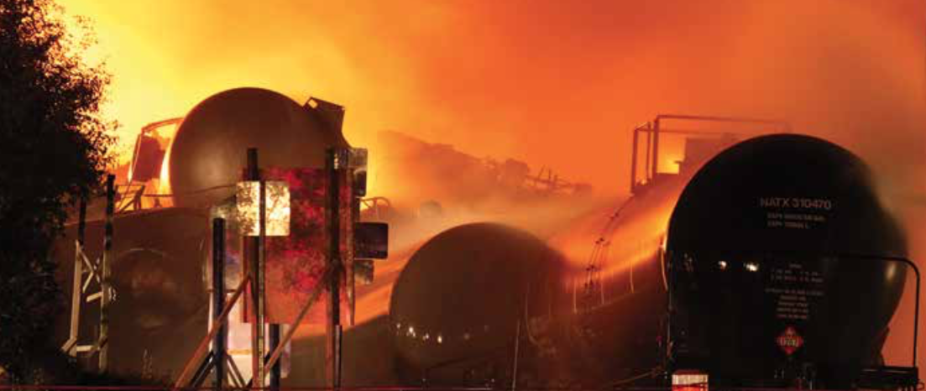
Lac-Mégantic
Just before 1 a.m., the air pressure had dropped to a point at which the combination of locomotive air brakes and hand brakes could no longer hold the train, and it began to roll downhill toward Lac-Mégantic, just over seven miles away. Top speed = 65 mph.
Train derailed near the centre of the town and breaches of tank cars occurred followed by explosions and fire.
*Based on Transportation Safety Board (2014 a and b) – with permission

Slide 14
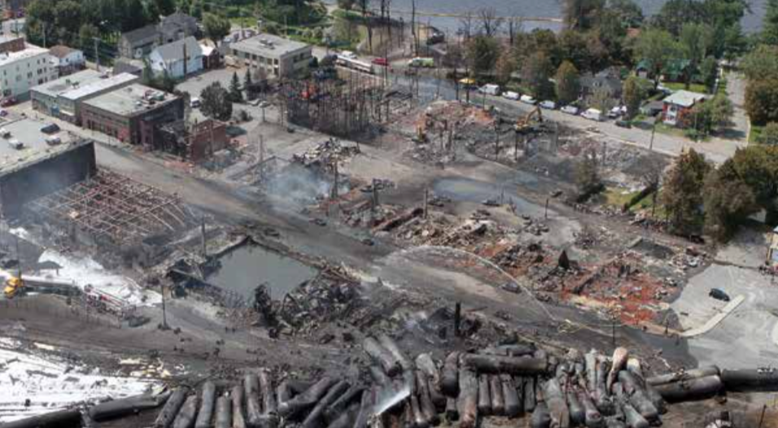
Lac-Mégantic
Almost all of the 63 derailed tank cars were damaged, and many had large breaches. About six million litres of petroleum crude oil was quickly released.
The fire began almost immediately, and the ensuing blaze and explosions left 47 people dead. Another 2000 people were forced from their homes, and much of the downtown core was destroyed.
*Based on Transportation Safety Board (2014 a and b) – with permission

Slide 15
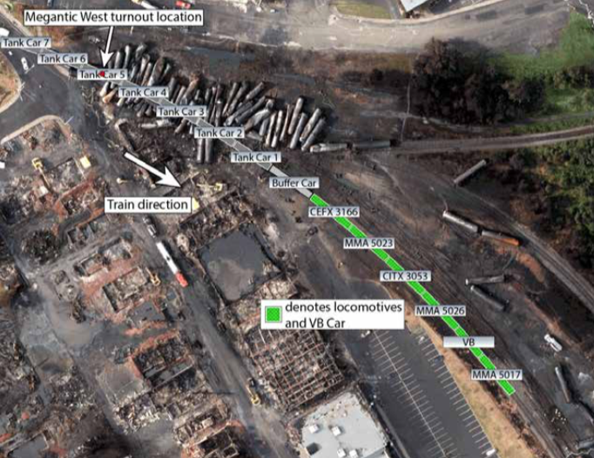
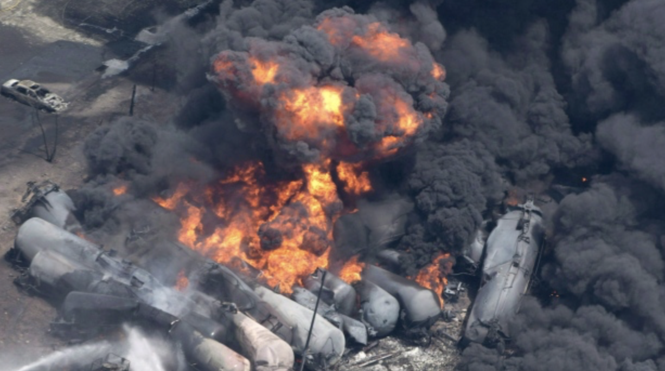
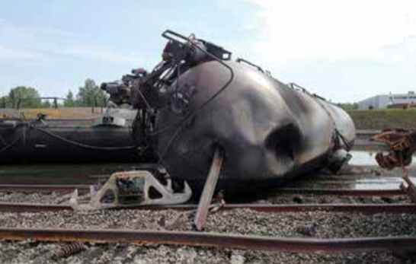
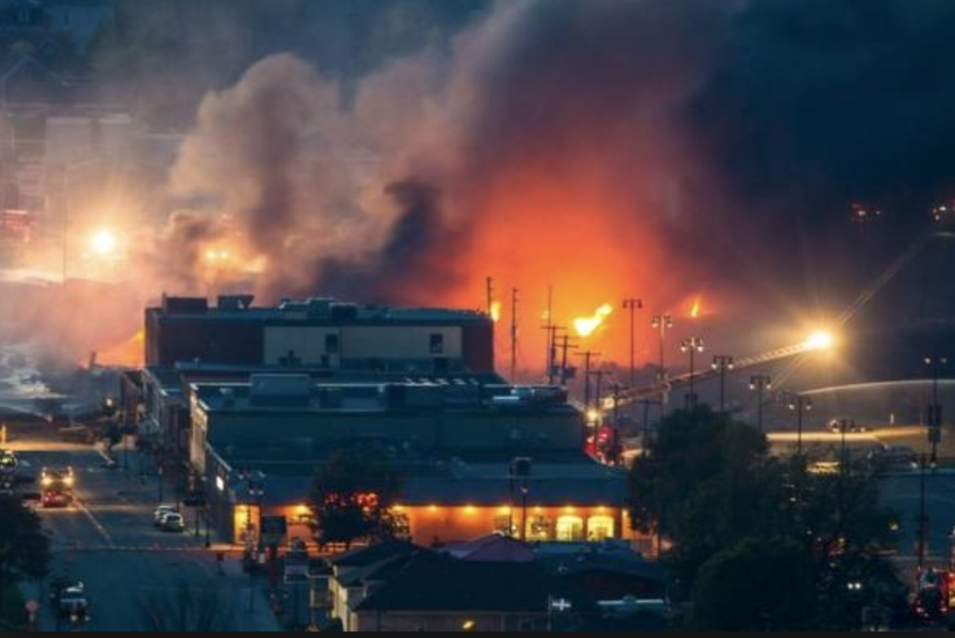
Lac-Mégantic
*Based on Transportation Safety Board (2014 a and b) – with permission

Slide 16
Lac-Mégantic - Weaknesses
An organization with a strong safety culture is generally proactive when it comes to addressing safety issues. MMA was generally reactive.
Significant gaps between the company’s operating instructions and how work was done day to day.
Employee training, testing, and supervision were not sufficient, particularly when it came to the operation of hand brakes and the securement of trains.
Although MMA had some safety processes in place and had developed a safety management system in 2002, the company did not begin to implement this safety management system until 2010—and by 2013, it was still not functioning effectively.
The petroleum crude oil in the tank cars was more volatile than described on the shipping documents. If petroleum crude oil is not tested systematically and frequently, there is a risk of it being improperly classified.
*Based on Transportation Safety Board (2014 a and b) – with permission

Slide 17
RMS - Discussion and Activity
Think about the elements of our Risk Management System and these topical areas in relation to the Loss Incident:
In the Lac-Mégantic Loss Incident, how/where did the RMS fail? Explain.
Risk Management System (APEGA Model):
Management Leadership, Commitment and Accountability.
Risk Assessment and Management of Risks.
Community Awareness and Emergency Preparedness.
Management of Change.
Incident Reporting, Investigation, Analysis and Actions.
Program Evaluation and Continuous Improvement.
Design, Construction and Start-up.
Operations and Maintenance.
Employee Competency and Training.
Contractor Competency and Integration.
Operations and Facilities Information and Documentation.
Topical areas:
MMA Railway Corp.
Locomotive
Tank Cars
Train Securement
Derailment
Transport Canada (gov’t org.)

Slide 18
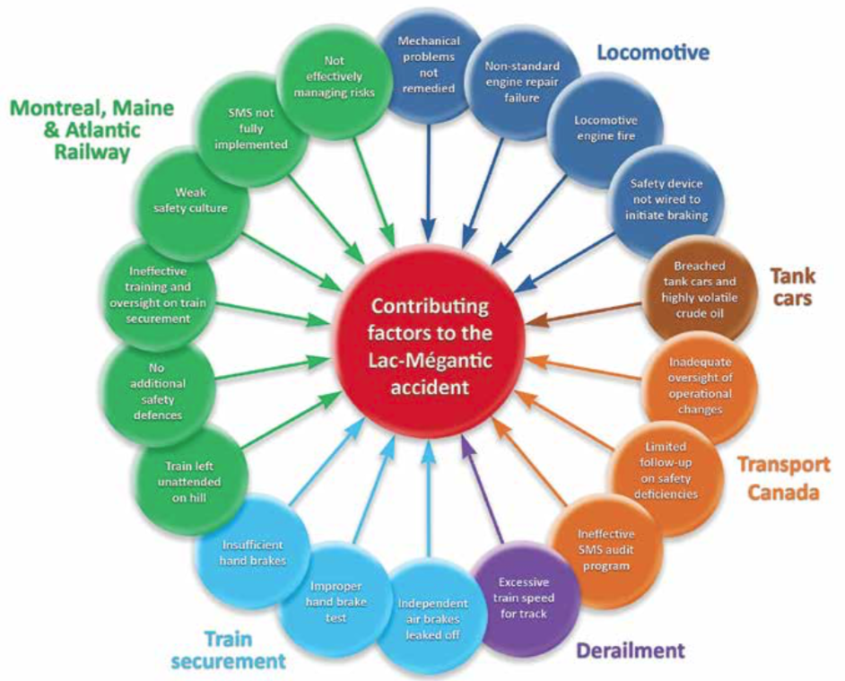
RMS - Discussion and Activity
*Based on Transportation Safety Board (2014 a and b) – with permission

Slide 19
References
Transportation Safety Board (2014a) TSB TSBOC. Runaway and Main-Track Derailment: Montreal, Maine & Atlantic Railway Freight Train MMA-002 Mile 0.23, Sherbrooke Subdivision, Lac-Mégantic, Quebec, 06 July 2013. 2014:1-191.
Transportation Safety Board (2014b) Government of Canada TSBOC. Lac-Mégantic Runaway Train and Derailment Investigation Summary. 2014:1-12.

Slide 20
Questions?
Do you have any questions aobut the Lac-Mégantic MMA Train Disaster?

